Slide 1
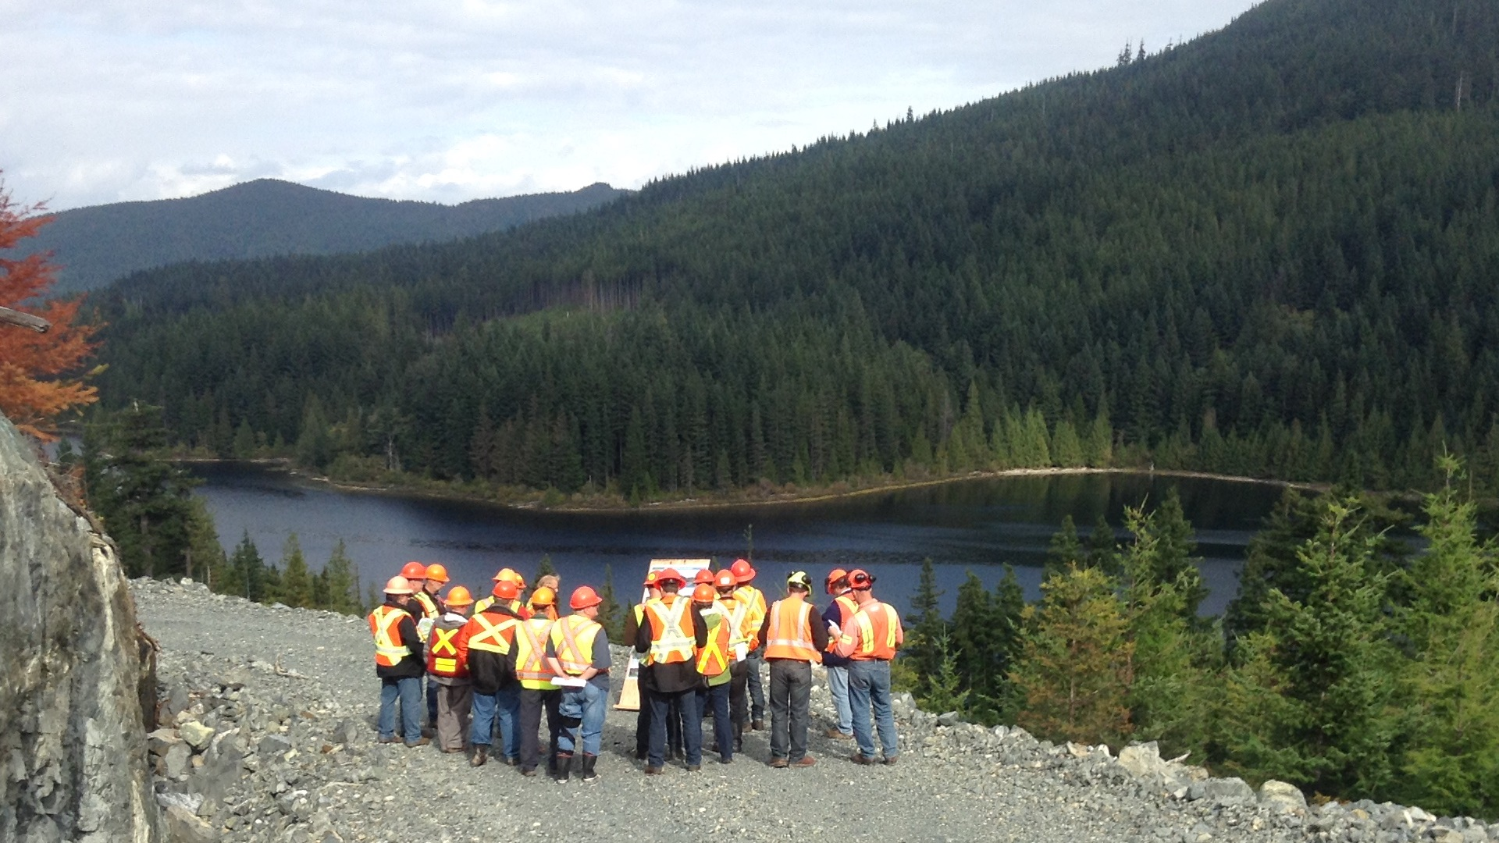

COAST THLB STABILIZATION
Bob Craven
April 15, 2015

Slide 2
Topics
What started the Coast AAC Stabilization discussion?
(Coast Industry Perspective)
What’s happening at the Coast OIF to deal with AAC Stabilization?
Real life example (Stella Lake) of a different approach
(Coast Industry Perspective)

Slide 3
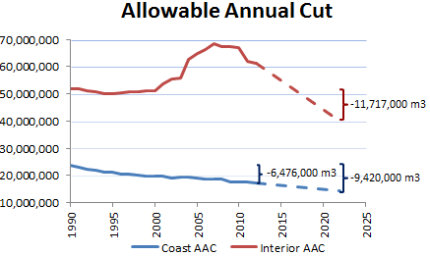
CAD-Beetle (Coast AAC Decline)
Across the Coast, the AAC has declined by 6.5 million m3 since 1990 and is on pace to decline by another 17% in the next decade.

Slide 4
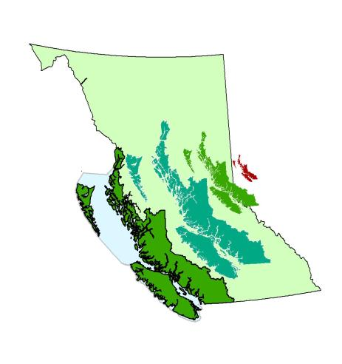
Coastal Forestry
Approximately 22% of Crown land base on the Coast lies in parks and protected areas.
Total area of BC:
95 million hectares
Land Available for Harvesting: 2.5 million hectares
TFLs 1.2 million ha
TSAs 1.3 million ha
Publicly Owned Forest Land: 7.6 million hectares
Publicly Owned Land: 14.5 million hectares
  3.2 million ha Parks and Protected Areas
Total area of Coast:
15.8 million hectares
Notes:
Does not include the Great Bear set asides

Slide 5
A Challenge to CRIT (Coast Region Implementation Team)
Verify the Crown land Coastal AAC from 1990 (or before) through 2012.
Identify the primary AAC drivers (+ and –) during the period with particular focus on those that remain relevant today and going forward.
Quantify the AAC and long run sustained yield (LRSY) influence of each driver through time.

Slide 6
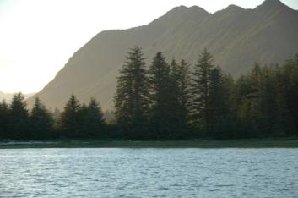
Coastal Forestry
Our AAC is declining as a result of land base withdrawals.
Notes:
Line graph to go here

Slide 7
Contributing Land Base Factors
  The key drivers affecting the THLB available for timber supply include:
    Parks, Ecological Reserves, etc.
    Riparian Management areas
    Wildlife and Biodiversity
    Land Use Order Management requirements

Slide 8
Stella Lake
Integrated Resource Management

Slide 9
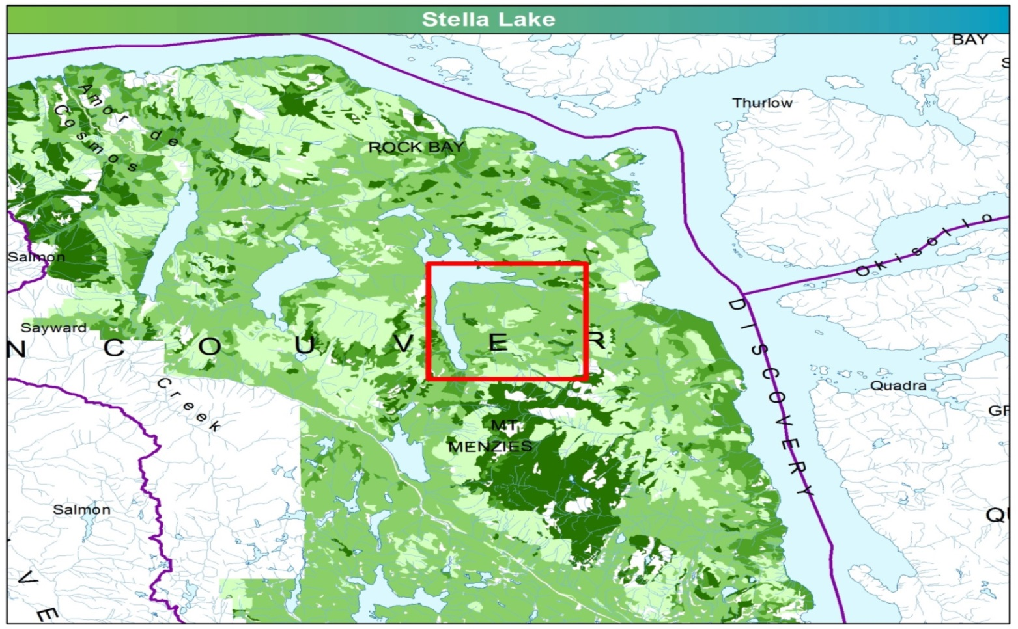
Stella Lake Integrated Resource Management

Slide 10
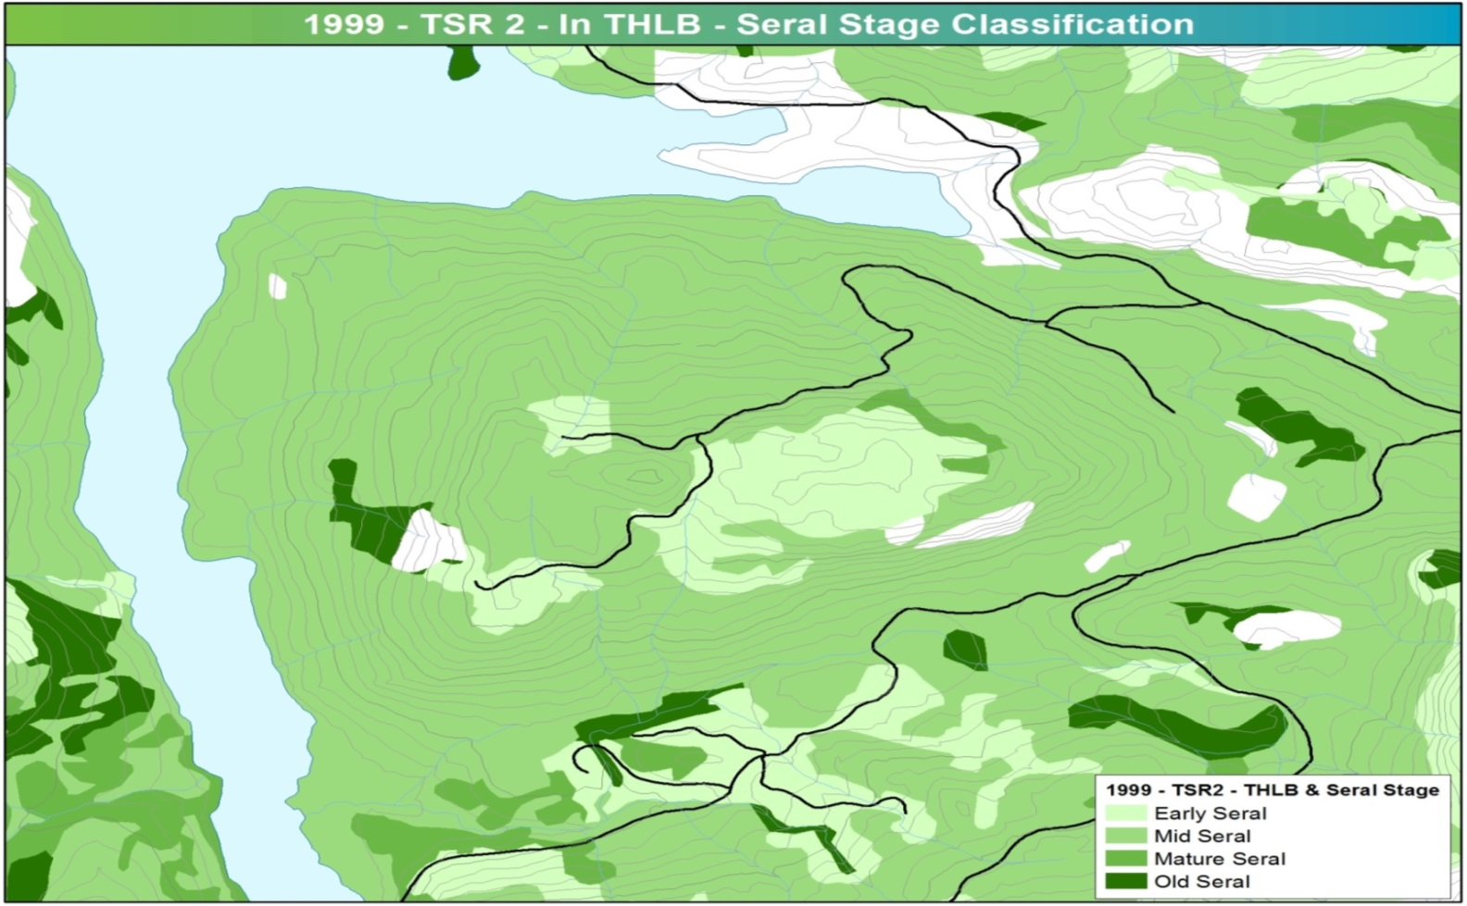
Stella Lake Integrated Resource Management cont’d.
TSR2 THLB = 1,350 ha

Slide 11
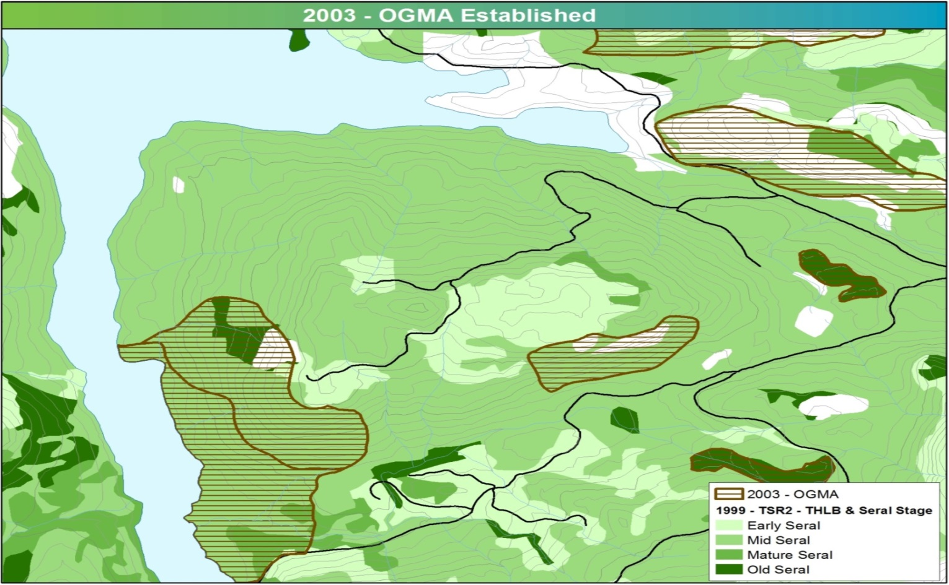
Stella Lake Integrated Resource Management cont’d.

Slide 12
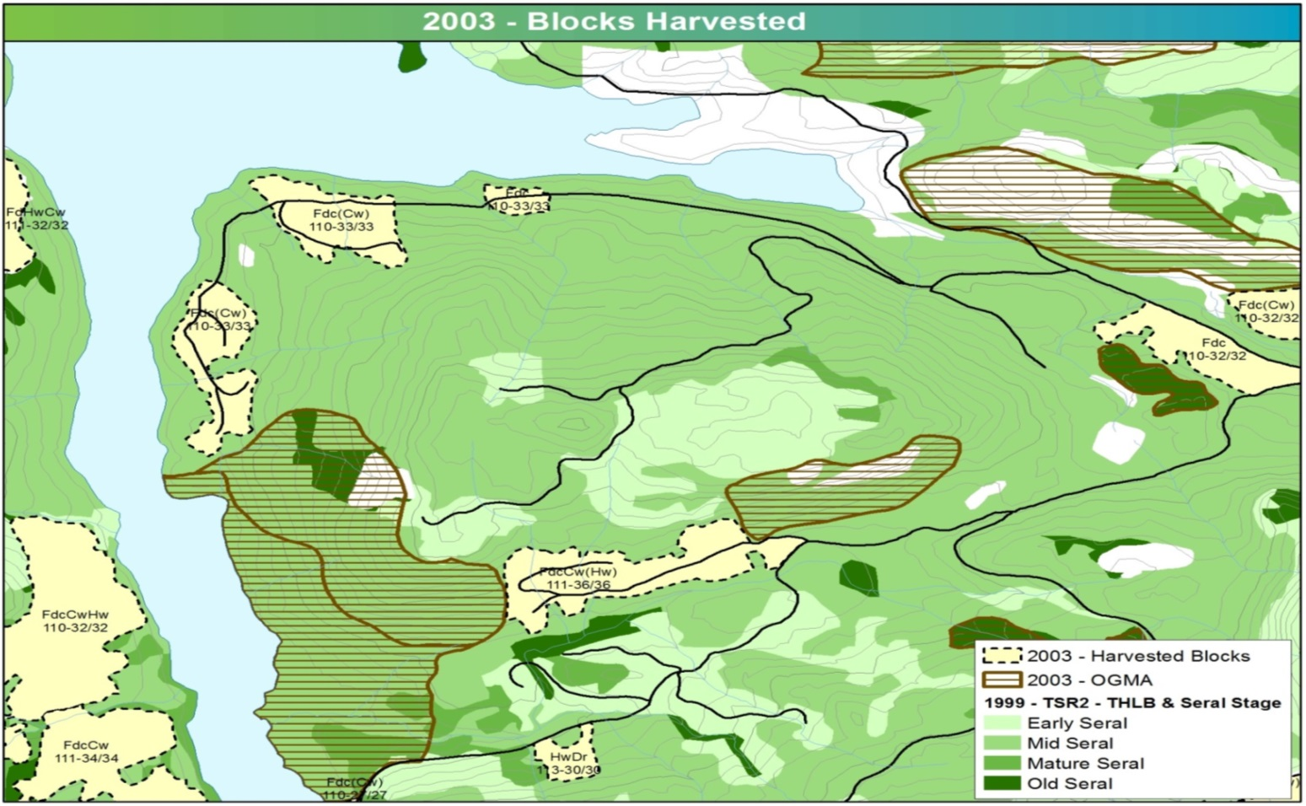
Stella Lake Integrated Resource Management cont’d.

Slide 13
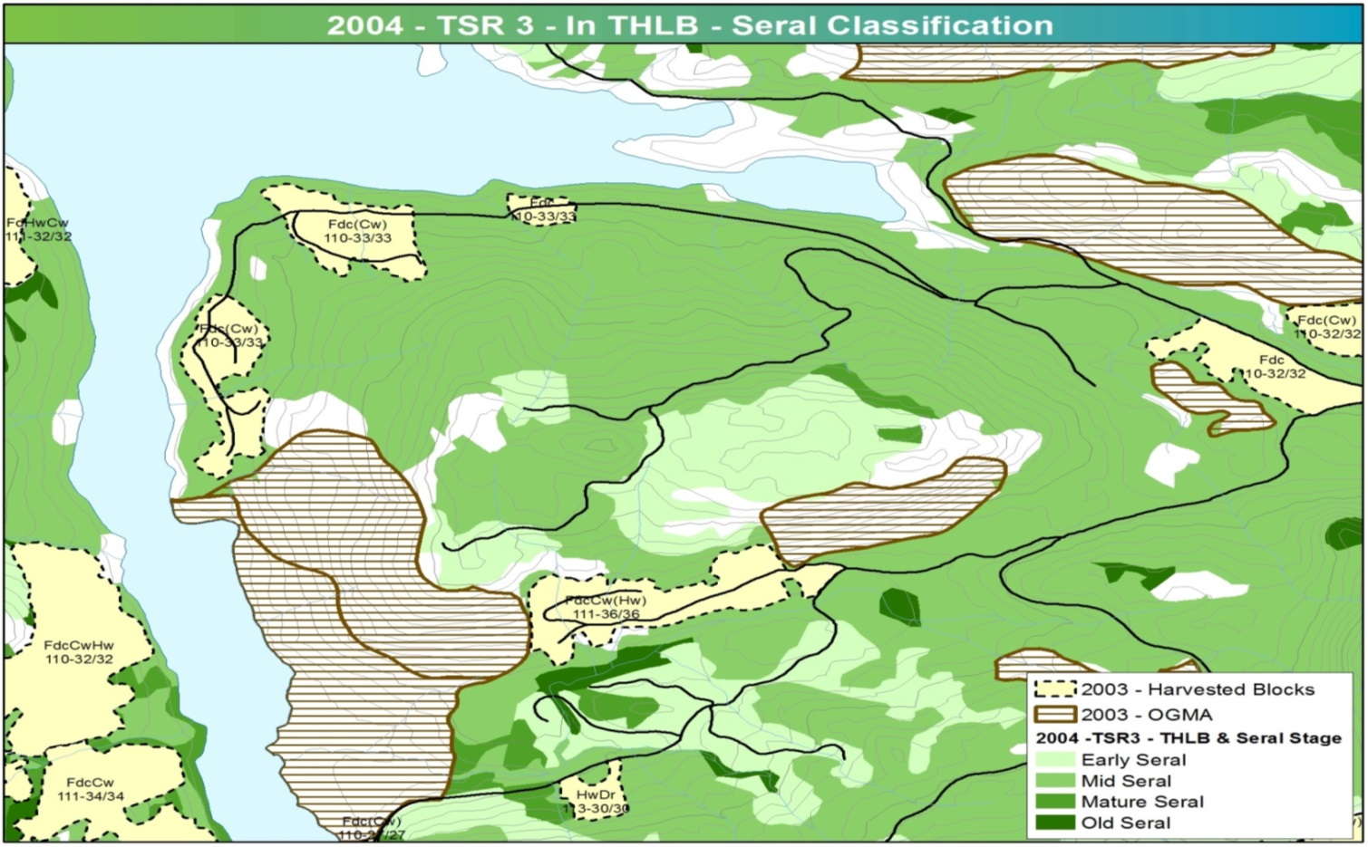
Stella Lake Integrated Resource Management cont’d.
TSR2 THLB = 1,350 ha
TSR3 THLB = 1,020 ha

Slide 14
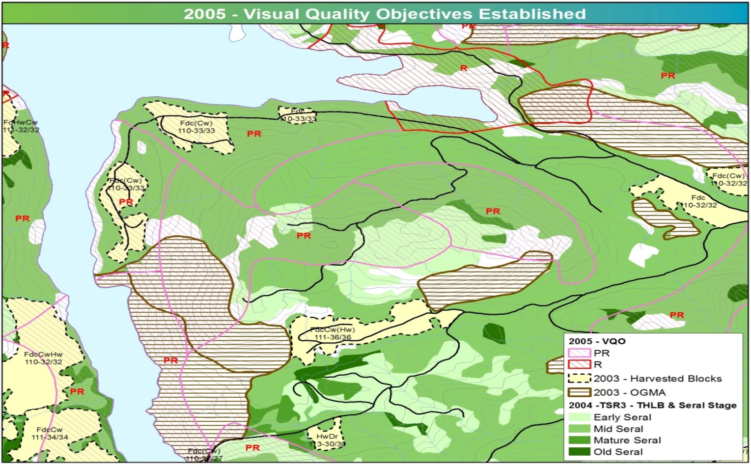
Stella Lake Integrated Resource Management cont’d.

Slide 15
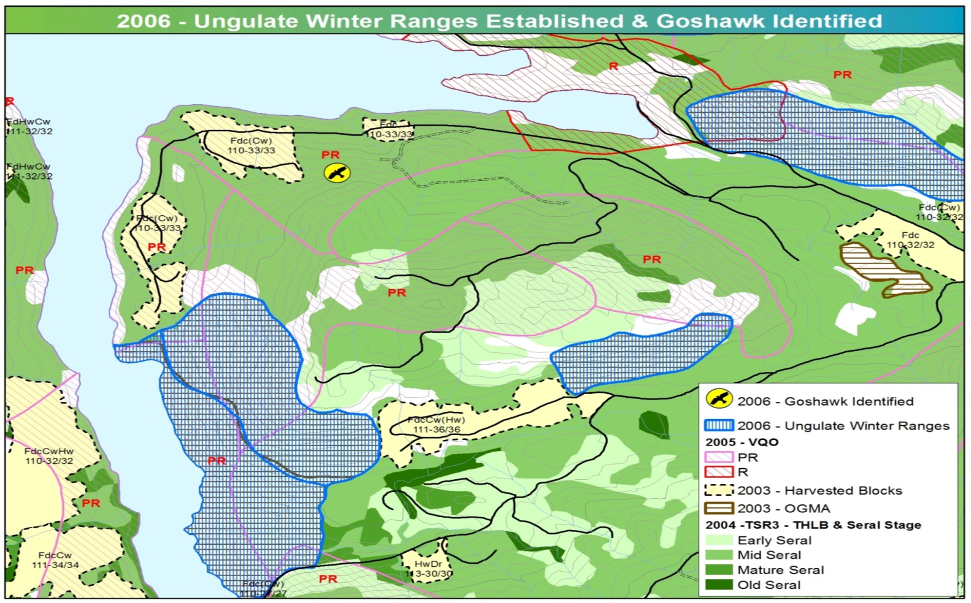
Stella Lake Integrated Resource Management cont’d.

Slide 16
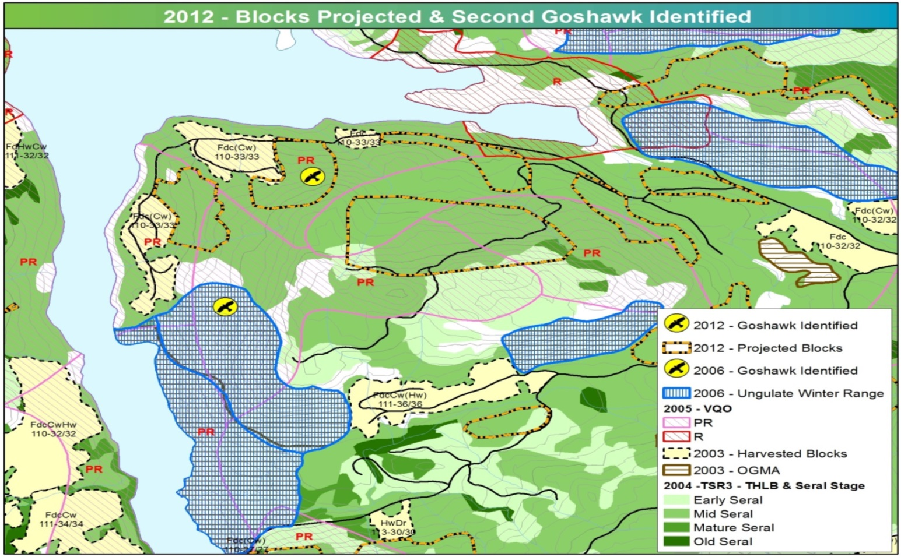
Stella Lake Integrated Resource Management cont’d.

Slide 17
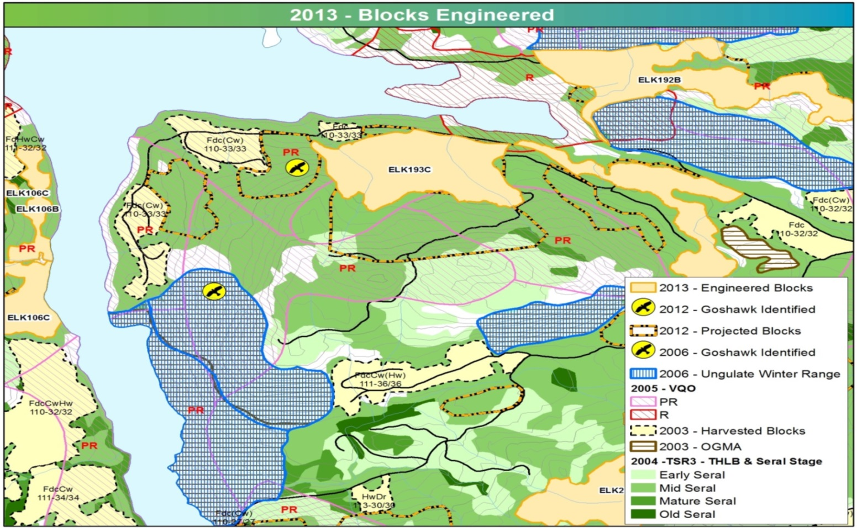
Stella Lake Integrated Resource Management cont’d.

Slide 18
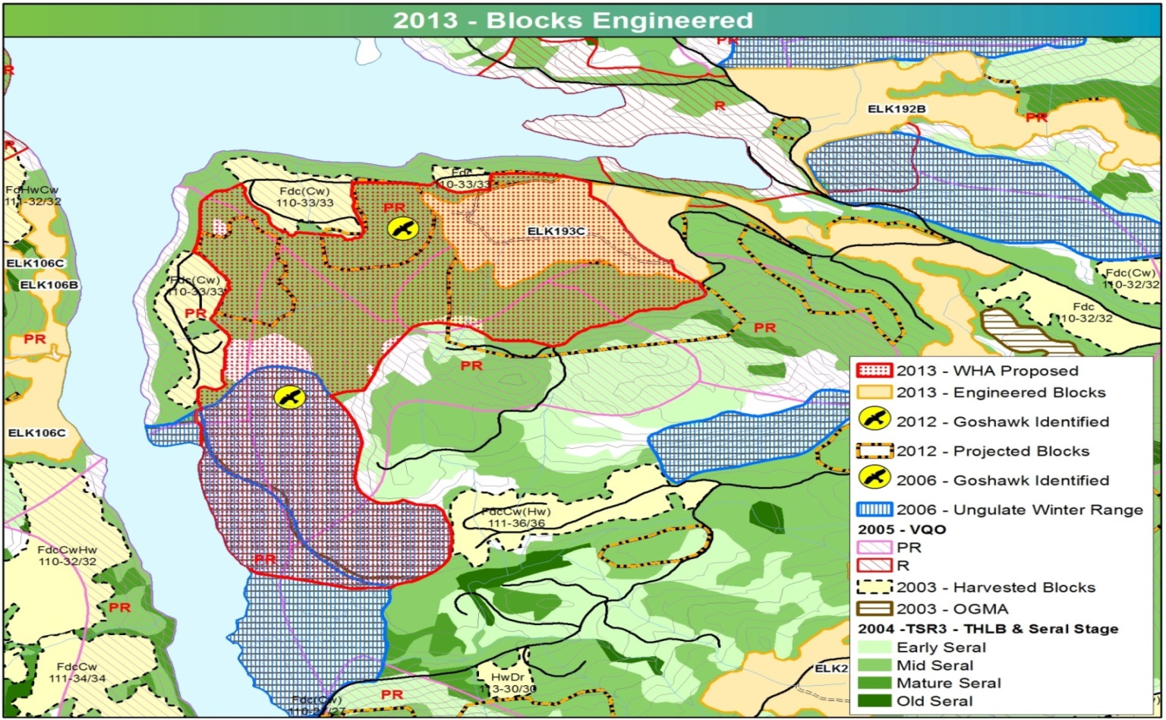
Stella Lake Integrated Resource Management cont’d.
TSR2 THLB = 1,350 ha
TSR3 THLB = 1,020 ha
THLB Revised for WHA Proposal = 873 ha
Loss of -35% since TSR2

Slide 19
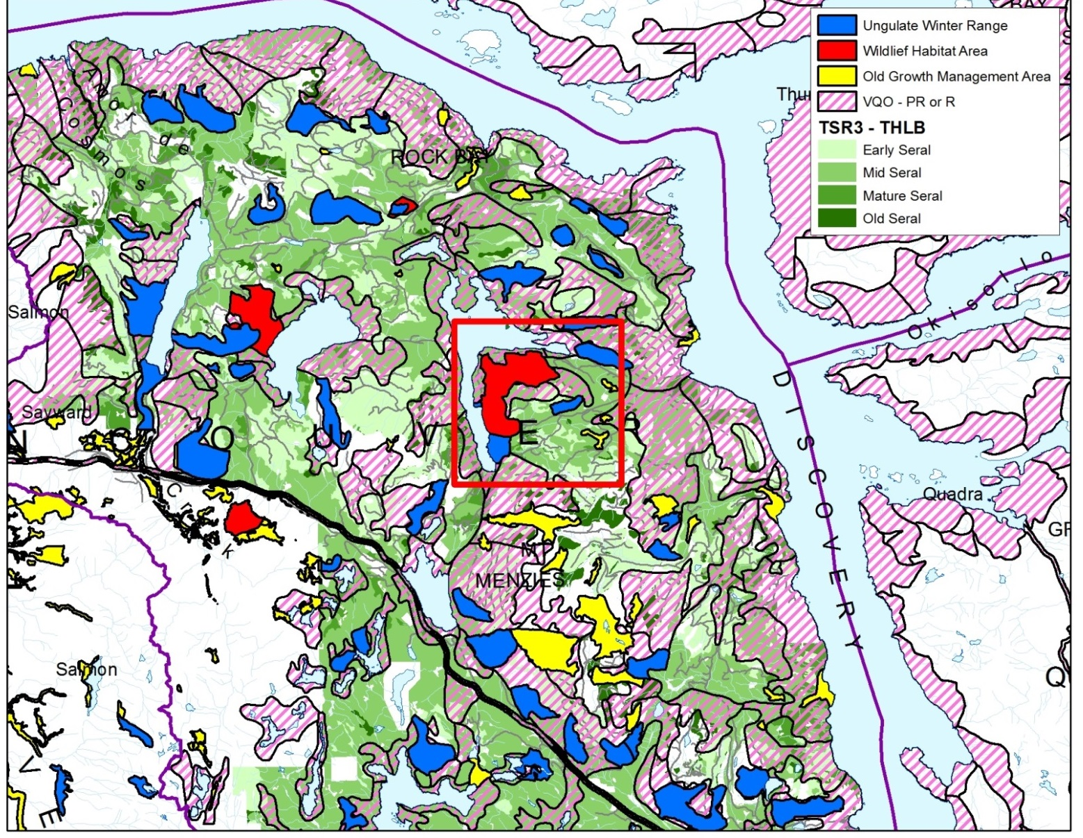
Managing Multiple Resource Values in Reality: Stella Lake
Timber becoming a residual value!

Slide 20
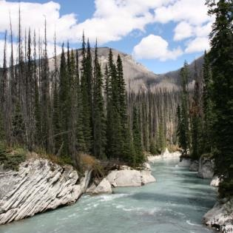
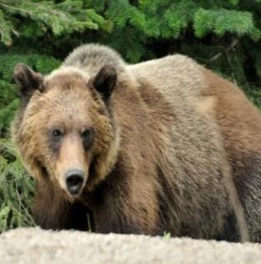
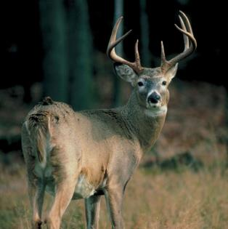
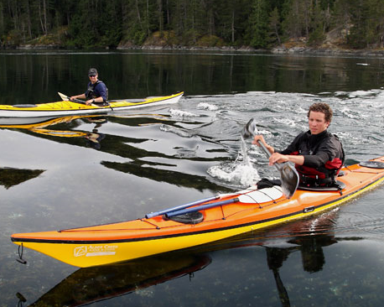
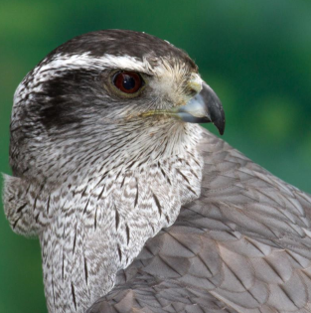
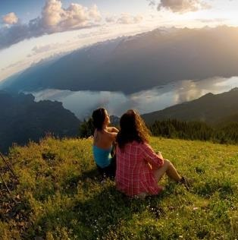
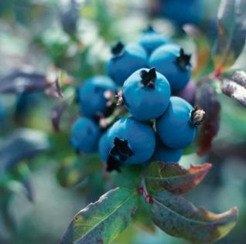
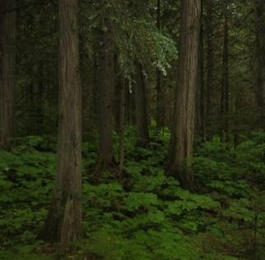
Managing For Multiple Resource Values
Time for a Fresh Approach
Watershed
Grizzly Habitat
Ungulate
Recreation
Non-Timber Forest Products
Goshawk
Scenic
Old Growth

Slide 21
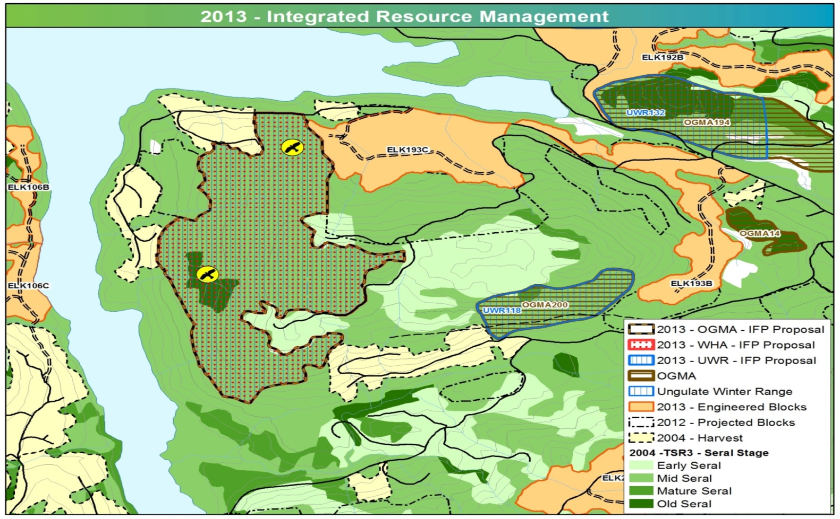
Stella Lake Integrated Resource Management
WHA, UWR, OGMA all overlapping 163 ha
TSR2 THLB = 1,350 ha
TSR3 THLB = 1,020 ha
THLB Revised for WHA Proposal = 1,027 ha
Loss of -24% since TSR2
No loss compared to TSR3
WHA Proposal Adjusted West
UWR & OGMA Adjusted
North

Slide 22
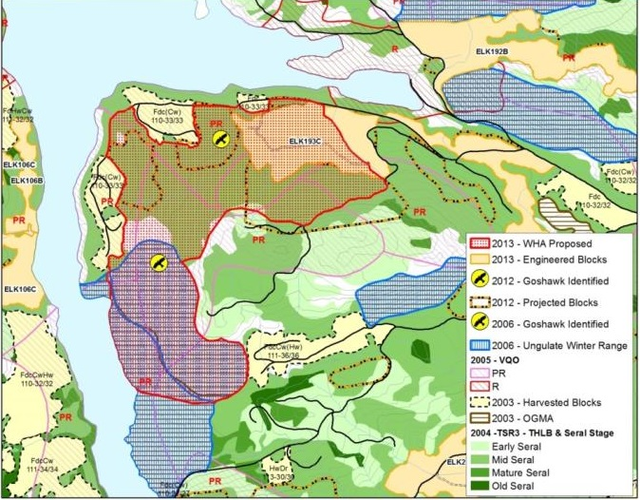
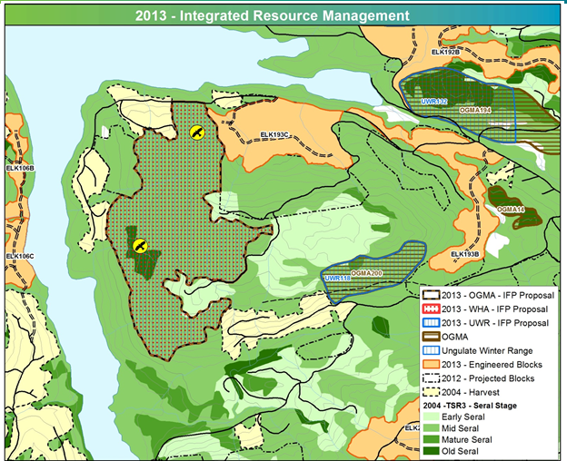
Managing Multiple Resource Values
Time for a Fresh Approach
Current Approach
Co-location Approach
Co-location reduces timber supply impact by 11%

Slide 23
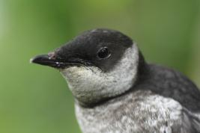
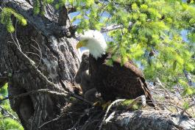
Coastal Forestry is Innovating . . . .
to Improve and Evolve Our Practices
Numerous Pilot Projects are underway by Coastal Forestry
  North Island IWMS Pilot
  San Josef Landscape Unit
  Arrowsmith
  Stella Lake
Pilot Projects are underway in the Interior
  Prince George TSA’s
  Kootenay Lake TSA
© John Deal
© John Deal
© John Deal
Stella Lake - An Example of Relevant Design

Slide 24
So why talk about THLB Stabilization on the Coast?
Opportunity to support viable forest sector on the Coast
Opportunity to increase revenue to the Crown
Opportunity to increase jobs
Opportunity to support healthy communities

Slide 25
Thank You
Questions?

